Slide 1
SB797 Update January 2020

Slide 2
3-County 1/8-Cent Sales Tax
2/3 of total votes across all 3 counties
Can exceed 2% local sales tax limit
~$108 million/year for operating & capital needs
SFC ~$26.5m; SMC ~$25m; SCC ~$56.5m
~$160 million/year for operating & capital needs if sales tax is added to existing member contribution levels

Slide 3
Current Resources

Slide 4
Resource Structure
Operating
Formula, based on all-day boardings updated annually
SOGR
Split evenly between members
New Capital Investments
Systemwide project (fleet expansion etc): split evenly between members
Locally focused improvements (station access/improvements etc): member agency supported
Grade Separations: Historically funded out of dedicated county funding sources
Gilroy Service
JPA specifies that VTA will cover all capital / operating
2000 cost was added to operating costs and shared according to operating formula

Slide 5
Projected Future Ridership
County | 2017 Existing Service | 2025 Initial Electrification | 2040 Long Range Service Vision
San Francisco | 17,010 | 23,130 | 59,280
 | 27% | 27% | 32%
San Mateo | 18,740 | 27,230 | 50,090
 | 30% | 31% | 27%
Santa Clara County | 26,330 | 36,080 | 75,330
 | 43% | 42% | 41%
Notes:
UPDATED with new count methodology. The split between counties uses NTD boarding counts.

Slide 6
Operating Contribution (in millions)
Notes:
Left 2008-2013

Slide 7
Operating Contribution by County (in millions)
County | FY20
San Francisco | $8.1
San Mateo | 9.1
Santa Clara | 12.7
TOTAL | $29.9
Notes:
Left 2008-2013

Slide 8
Capital Contribution by County (in millions)
County | FY18 | FY19 | FY20
San Francisco | $5.0 | $7.5 | $7.5
San Mateo | 5.0 | 7.5 | 7.5
Santa Clara County | 5.0 | 7.5 | 7.5
TOTAL | $15.0 | $22.5 | $22.5
Notes:
Left 2008-2013

Slide 9
Combined Capital & Ops vs. Ridership (in millions)
County | FY20 | % of FY20 | % of riders
San Francisco | $15.6 | 30% | 27%
San Mateo | 16.6 | 32% | 30%
Santa Clara County | 20.2 | 38% | 43%
TOTAL | $52.4
Notes:
Left 2008-2013

Slide 10
SOGR Contribution (in millions)
Category | FY20 Submitted | FY20 Adopted | Variance
Right of Way / Signal & Communications | $27.4 | $20.9 | $(6.5)
Rolling Stock | 15.4 | 5.1 | (10.3)
Station & Intermodal Access | 7.0 | 4.9 | (2.1)
TOTAL | $49.8 | $30.8 | $(19.0)
NOTE: Historically Caltrain has deferred about 40-50% of submitted capital projects for SOGR
Notes:
Left 2008-2013

Slide 11
FY20-22 Budget Outlook (in millions)
FY20 Budget | FY20 Projection | FY21 Projection | FY22 Projection | FY23 Projection
Total Operating Revenue | $120.7 | $127.2 | $130.2 | $163.7
Total Contributed Revenue | 37.0 | 37.0 | 37.0 | 37.0
Grand Total Revenue | 157.7 | 164.2 | 167.2 | 200.7
Total Operating Expense | 128.7 | 134.7 | 141.1 | 198.3
Total Administrative Expense | 24.4 | 24.8 | 26.1 | 27.8
Long Term Debt Expense | 2.6 | 2.4 | 3.5 | 3.5
Grand Total Expense | 155.7 | 161.9 | 170.7 | 229.6
Net Surplus / (Deficit) | $2.0 | $2.3 | $(3.5) | $(28.9)
Note: Projections include adopted fare changes. FY23 projection is preliminary and includes electrification
Notes:
RH-added farebox recovery ratios

Slide 12
Surplus/(Deficit)
Includes adopted fare changes
Notes:
Shows FY19 budget, not forecast

Slide 13
Future Investments + Service
Notes:
Left 2008-2013

Slide 14
Future Operating: 2040
Current operations include
Max 5tphpd in peak with 92 trains per day
Highly limited service south of Tamien
2040 projections assume at least 8tphpd in peak with 268 trains per day
Significant expansion of train service south of Tamien

Slide 15
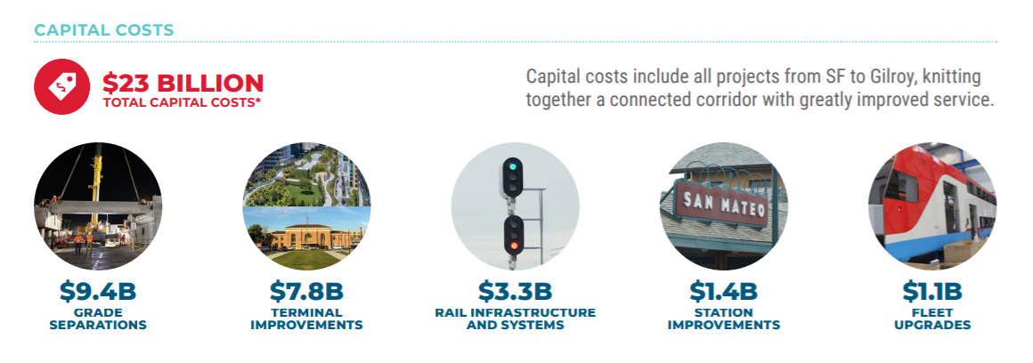
Future Capital: 2040

Slide 16
7 Agency Approval Process
1. Caltrain Board of Directors
San Mateo County
2. Transit District Board of Directors
3. Board of Supervisors
San Francisco
4. SFMTA Board of Directors
5. Board of Supervisors (2/3)
Santa Clara County
6. VTA Board of Directors
7. Board of Supervisors (2/3)

Slide 17
Next Steps
Finalize Resolution
Define Expenditure Plan
Supplement vs. Replace Existing Contributions
Initiate Approval Process (March – July)

